Slide 2
Introduction to ASP.NET Core & Visual Studio Code
Clemens Schotte
Technical Evangelist

Slide 3
Time | Min. | Session
10:00 – 10:05 | 5 | Welcome
10:05 – 10:30 | 25 | Session 1 - Microsoft Edge, a break from the past
10:30 – 11:15 | 45 | Session 2 - Innovations of the web
11:15 – 11:45 | 30 | Session 3 - Modern front-end tooling in Visual Studio
11:45 – 12:30 | 45 | HOL - Modern front-end tooling in Visual Studio (part 1)
12:30 – 13:30 | 60 | Lunch
13:30 – 14:00 | 30 | HOL - Modern front-end tooling in Visual Studio (part 2)
14:00 – 14:30 | 30 | Session 4 - Introduction to ASP.NET Core & Visual Studio Code
14:30 – 15:00 | 30 | HOL - Introduction to ASP.NET Core 1.0
15:00 – 15:15 | 15 | Break
15:15 – 16:00 | 45 | Session 5 - Introduction to Azure for web developers
16:00 – 16:50 | 50 | HOL - Getting started with Azure App Service Web Apps
16:50 – 17:00 | 10 | Conclusion

Slide 4
.NET Framework

Slide 5
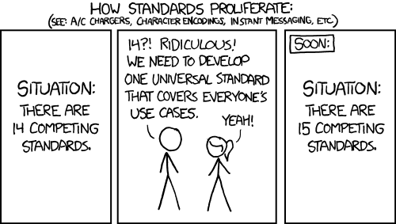

Slide 6
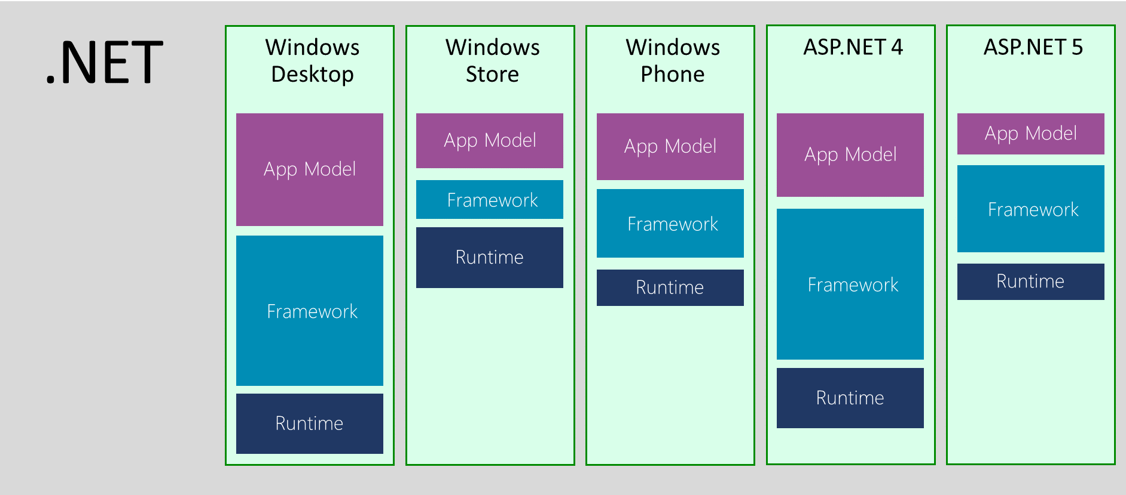

Slide 7




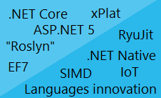







The road ahead for .NET
ASP.NET 5
.NET Core
.NET Innovation
Open Source
Cross-Platform

Slide 8
Why is Microsoft open sourcing .NET?
Lay the foundation for a
.NET cross-platform
Leverage a stronger ecosystem,
Client
Cloud and Services
.NET cross-platform
.NET ecosystem
Our services, tools are attractive to a larger audience!

Slide 9

Open Source way of work
.NET accepts contributions!
.NET development in the Open
Live Code changes
Code Reviews
Design documents
Discussions
Recording design meetings
Recording pull requests discussions
Bug tracking
Github Pull request model
Criteria of acceptance based on Roadmap and Quality
Other inputs:
User Voice
Connect

Slide 10
.NET Core

Slide 11

.NET 2015
WPF
Windows Forms
ASP.NET
(4 & 5)
ASP.NET 5
Universal
Windows Apps
.NET Framework 4.6
.NET Core 5
CoreCLR
.NET Native runtime
Fully-featured and integrated
.NET libraries and runtime for Windows
Modular and optimized
.NET libraries and runtimes
Shared
Runtime components
Libraries
Compilers
RyuJIT + SIMD
Garbage Collector
Base class libraries
NuGet packages
.NET Compiler Platform (Roslyn)
Languages innovation

Slide 12


Open sourcing .NET
What did Microsoft open source? (2015)
.NET 2015
Platforms
General purpose .NET Core runtime, compilers and libraries
ASP.NET 5 web server stack
Fully supported cross-platform
Windows, Linux and OS X
Visual Studio tooling support (e.g. debugging and deploying to Docker in Linux)
Omnisharp extensions to cross-plat IDEs (Sublime, Emacs…)
Open Source
.NET Core and ASP.NET 5 source being developed on GitHub
Contributions accepted, tested and fully supported
Close collaboration with Mono community
.NET
Framework 4.6
.NET
Core 5
Common
Runtime components
Compilers
Libraries
.NET Compiler Platform
(“Roslyn”)
Languages
.NET Core 5 Libraries
.NET Framework 4.6 Libraries
RyuJIT, SIMD
Core-CLR
Get started from:
github.com/microsoft/dotnet

Slide 13
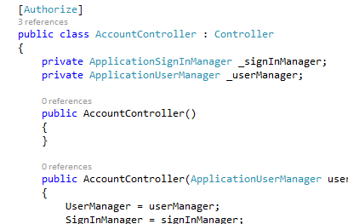
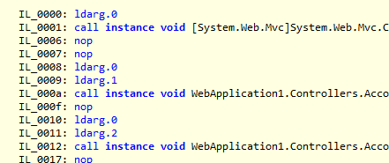

Code / Build / Debug
Deploy & Run
Roslyn takes your code and compiles it to IL. You have very modular references to the BCL and App Model you’re targeting.
References are built with your app into one native dll deployed locally with runtime
my.exe (stub)
my.dll
.NET Native tool chain
Code
(my.cs)
WinStore
.NET Native Runtime
Roslyn
IL
my.dll
+referenced dlls
ASP.NET
JIT Compiler
(RyuJIT)
+
+
CoreCLR
BCL
App Model
References & CoreCLR are deployed with app locally, JIT compilation on start up
References (Modular, NuGet)

Slide 14
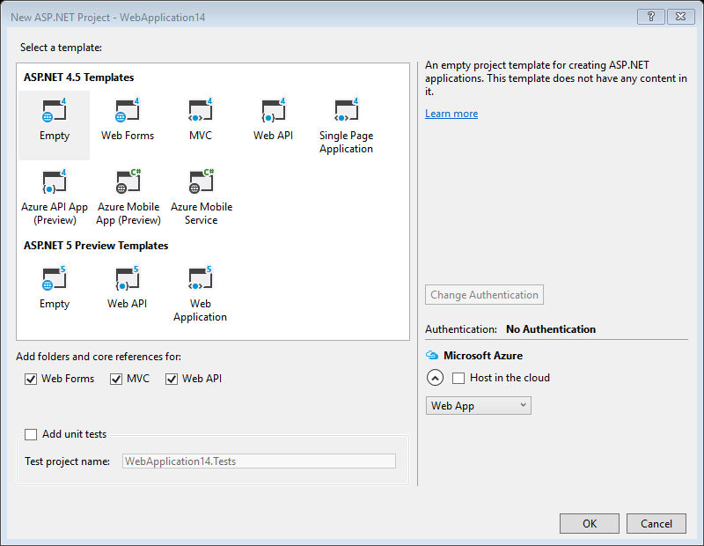
ASP.NET Core 1.0 New, but still one project type
Visual Studio 2015 – New ASP.NET Project

Slide 15
ASP.NET Core 1.0
One set of concepts – remove duplication
Web UI and Web APIs
Smooth transition from Web Pages to MVC (future)
Runs on IIS or self-hosted

Slide 16


ASP.NET Core 1.0 – Key Values
Totally Modular
Faster Development Cycle
Seamless transition from on-premises to cloud
Choose your Editors
and Tools
Open Source with Contributions
OSS
Cross-Platform
Fast

Slide 17

ASP.NET 2015 in a Nutshell
Visual Basic
Visual Basic (coming soon)
C#
Web
Forms
MVC 5.x
Web API 2.2
ASP.NET Core 1.0 app features:
MVC, API, etc.
ASP.NET 4.6 / System.Web
ASP.NET Core 1.0
Core CLR
.Net Native
.NET Framework 4.6
.NET Core 1.0
Full .NET Framework for any scenario and
library support on Windows
Modular libraries & runtime optimized for server and cloud workloads

Slide 18
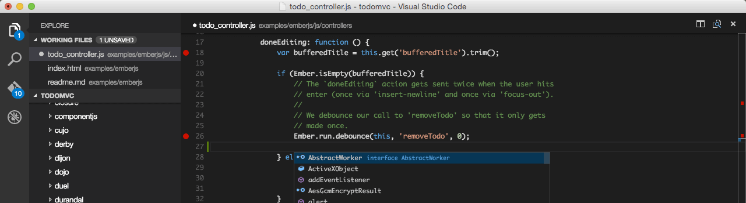
Visual Studio Code
A cross platform editor optimized for building and debugging modern web and cloud applications.

Slide 19
Demo
Getting started with ASP.NET Core 1.0

